Slide 1
Outline
Determined the project object: TripAdvisor-like app for querying well know art at travel destinations.
Decided on artform, initially was painters and sculptors.
Determined the definition of ‘well-known’ or ‘popular’ art.
artwolf.com
ranker.com
mymodernmet.com
Located sources of art, i.e., museums
Each of us selected a region within the Midwest

Slide 2
Acquire data
ETL diagram
Museum
Project 3
End-user app
museums
Import: Iowa.csv,
MIA.csv,
Top101painters.csv,
Topsculpturists.csv
*.csv
a. Metadata
API call
Input: artfiltered.json
Beautiful Soup (module 11)
Iowa.ipynb
pgAdmin
PostgreSQL
(module 9)
artfiltered.sql
(module 14)
artfiltered.js
Flask
(module 11)
artfiltered.py
Output: Iowa.csv
Output:
ERD
artfiltered.csv
Output: artfiltered.json
Direct data entry
Top lists
A chicken crossing the road is poultry in motion.
Theartwolf

Slide 3
Top Lists
Artwolf.com
Splinter
Beautiful soup
Scrape 5 different times for 4 different pieces of data (
Pandas
ranker.com
mymodernmet.com
The hardness of the butter is proportional to the softness of the bread.

Slide 4

Carnegie Museum of Art
Source: json data via GitHub, 78,000 records
Imported data in Pandas jupyter
Filtered on 4 different of art
Data cleaning
Went into sql
Ran into upload csv problems
Query reduced that to 250 records
If you take your laptop for a run, you jog your memory.

Slide 5
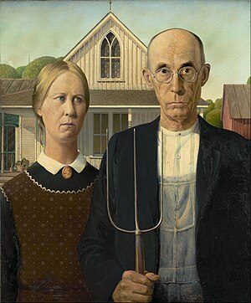
Chicago Institute of Art
Source: json data via GitHub, 78,000 records
Imported data in Pandas jupyter
Filtered on 4 different of art
Data cleaning
Went into sql
Ran into upload csv problems
Query reduced that to 250 records
Santa's helpers are subordinate clauses.

Slide 6
Cleveland Museum of Art
Source: json data via GitHub, 78,000 records
Imported data in Pandas jupyter
Filtered on 4 different of art
Data cleaning
Went into sql
Ran into upload csv problems
Query reduced that to 250 records
A boiled egg in the morning is hard to beat.

Slide 7
Final output
Panda dataframe and csv.file of combined data from all three museums:
Postgres database ‘art’
Pretty formatting of large sets of data:
Creating of an html file
CSV convertor
3rd one ???
Another library?
Borrow money from pessimists – they don’t expect it back.

